Slide 1
NCEA INTERNAL ASSESSMENT
GAME PROGRAM
1.1 Create a computer program
5 credits

Slide 2
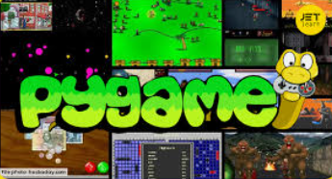
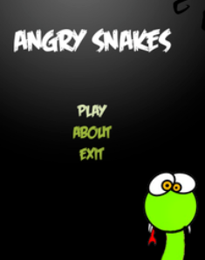
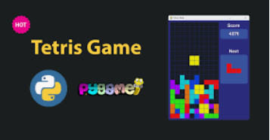
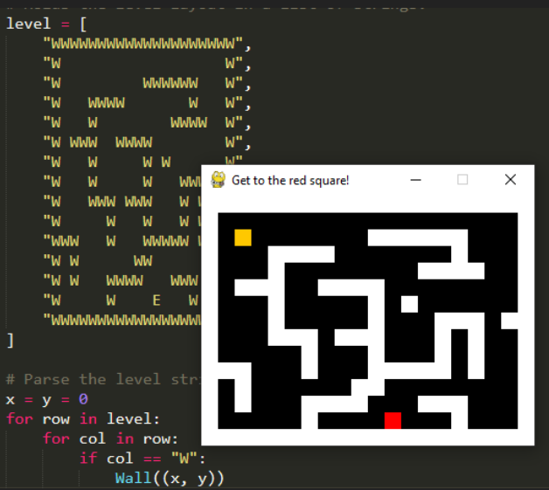
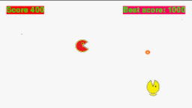

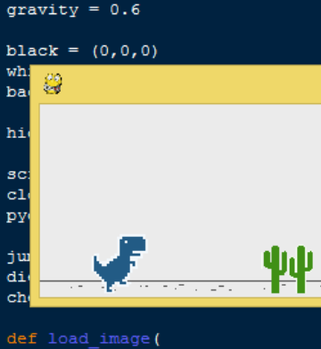
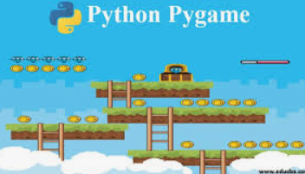
GAME PROGRAMMING
You will develop a game in a suitable programming language. Games can be used for all kinds of purposes including telling stories, teaching concepts, connecting with others, practicing skills, or just fun.
Computer programming is what drives our games, so what better way to practice your programming skills than by developing a game?

Slide 3
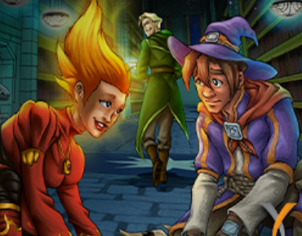
GAME IDEA
Outline your idea for a game. Include objectives, story and context (not directly assessed)
Sample Idea: Wizard Duel: In the mystical lands of Eldoria, two rival wizards face off in the annual Arcane Conclave. Players select spells like Flame Burst, Frost Shield, or Thunder Strike, aiming to outwit each other by predicting and countering their opponent’s moves. To gain extra spells or power-ups, players must answer trivia about magical lore, with the objective to win the best of three duels and be crowned the Grand Sorcerer.
Sample Idea: Fairy Rings: In the realm of Faelight, players summon fairies into rotating rings in the sacred grove. Answering folklore questions earns the ability to rotate or lock a ring for a round, aiming to strategically align three fairies in a row despite the rings' movements to control the convergence of ley lines and gain ultimate power.

Slide 4
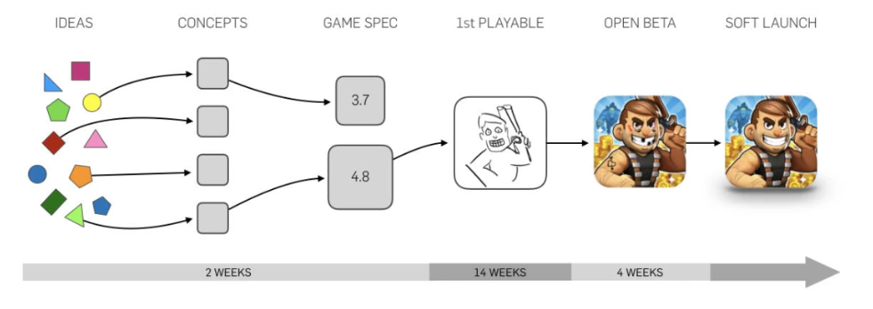
GETTING STARTED
Here are some features to help you plan.
Rules — A player needs to know that if they do action A, consequence B will follow.
Challenge —Objective?. Collect 5 rings. Beat the level in 10 seconds. Get the best time, or highest score. Does a player ‘win’ your game?
Level of difficulty — if a game is too easy it is boring, if a game is too difficult it is frustrating. Getting the difficulty level just right is a challenge.
Mastery — if you play or practise a game enough, you should get better at it.
A story — not all games tell a story, but yours could

Slide 5
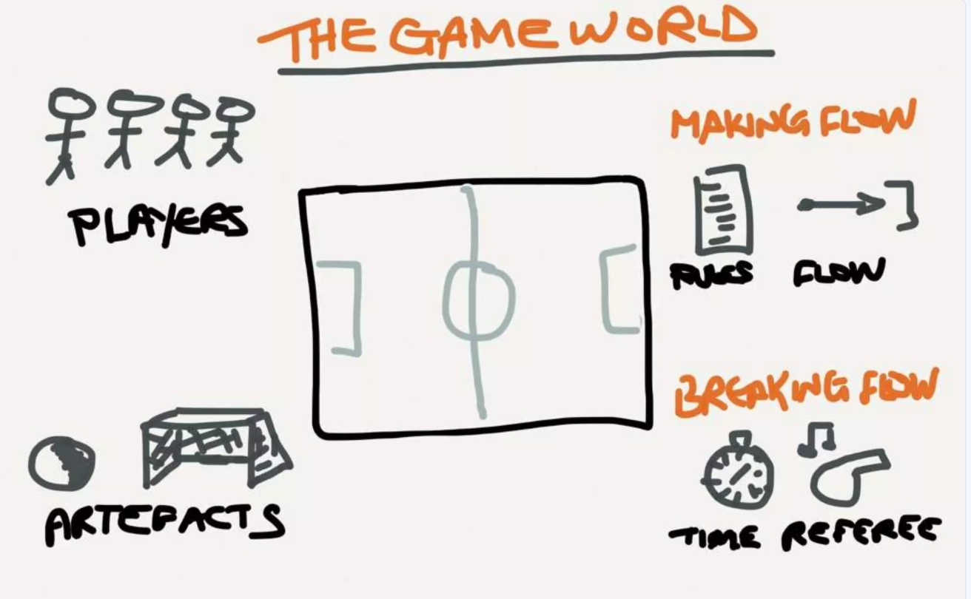
PLANNING
Plan your game — this may take the form of a brainstorm or spider diagram, a storyboard, or concept sketches.
Planning is not directly assessed.

Slide 6
Overview of Your Game
What is your game about? (Briefly describe the concept. Is it a platformer, puzzle, adventure, or strategy game? What is the player’s goal?)
Who is your intended audience? (Is the game for kids, casual players, or experienced gamers?)

Slide 7
Game Mechanics
How does the game work? (Explain the core mechanics: How does the player interact? What actions can they take? Are there different levels or challenges?)
What are the rules of the game? (Describe how players win, lose, or progress.)
How does scoring or progression work? (Does the player earn points, advance levels, or unlock rewards?)

Slide 8
Programming Features
Your game must include the following elements: ✅ Stores at least two types of data in variables
(e.g., player name, score, health, inventory). ✅ Takes user input and produces output
(e.g., moving a character, pressing keys, menu selection). ✅ Uses conditionals and loops
(e.g., if-else statements for game logic, loops for movement or repeating game events). ✅ Uses a data structure
(e.g., lists for inventory, dictionaries for settings, arrays for game levels).

Slide 9
Programming Features
Explain how your program meets these requirements:
How is data stored and updated in your game? (Give an example.)
How does the player interact with the game? (Describe user inputs like arrow keys, spacebar, mouse clicks.)
What conditionals (if statements) and loops do you use? (Explain how they help control game behavior.)

Slide 10
TESTING
Identify some test cases for your game.
What edge cases or unexpected inputs did you test? (e.g., entering invalid commands, moving beyond screen boundaries, incorrect inputs.)
How did you handle errors? (Did you add error messages, game over screens, or restart options?)
What improvements did you make based on testing? (Provide an example of a bug you fixed.)

Slide 11
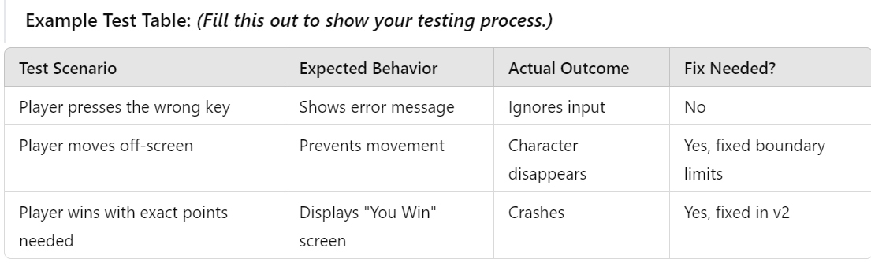
TESTING

Slide 12
🕷️ Debugging Slide
Keep track of stages of your program development as a log – what works, what you have tested, what have you fixed. Remember to include screenshots of the broken and fixed code (only need the lines that you changed).

Slide 13
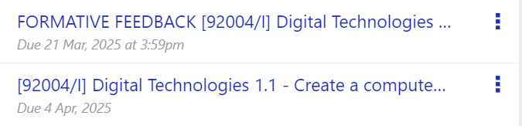
TIMEFRAME – please check OLE for the most up to date checkpoints and final deadlines

Slide 14
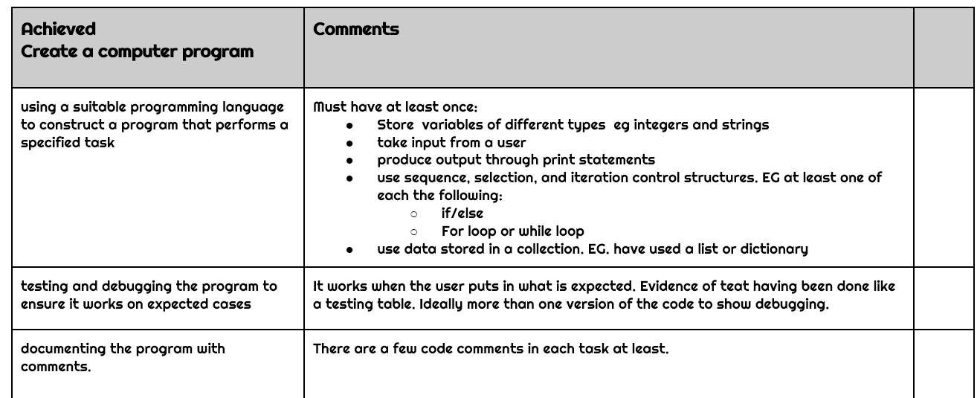
RUBRIC - ACHIEVEMENT

Slide 15
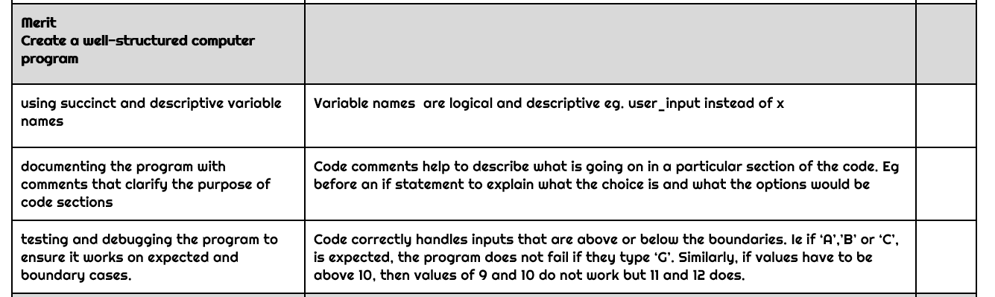
RUBRIC - MERIT

Slide 16
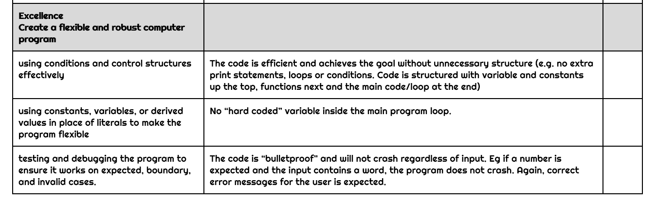
RUBRIC - EXCELLENCE

Slide 17
Final Submission
Final file to mark: -- insert name of file example: paraglider_vs3.py --
Share your onedrive assessment folder with your teacher
Final Reflection:
What challenges did you face, and how did you overcome them?
What would you improve if you had more time?
What did you learn from this project?

Slide 18
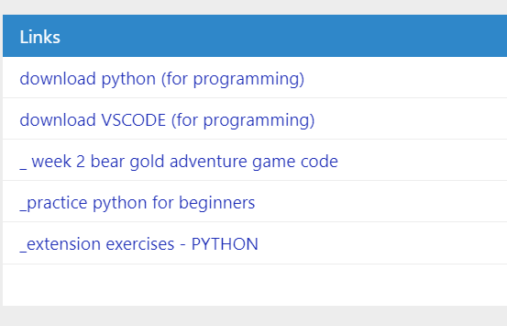
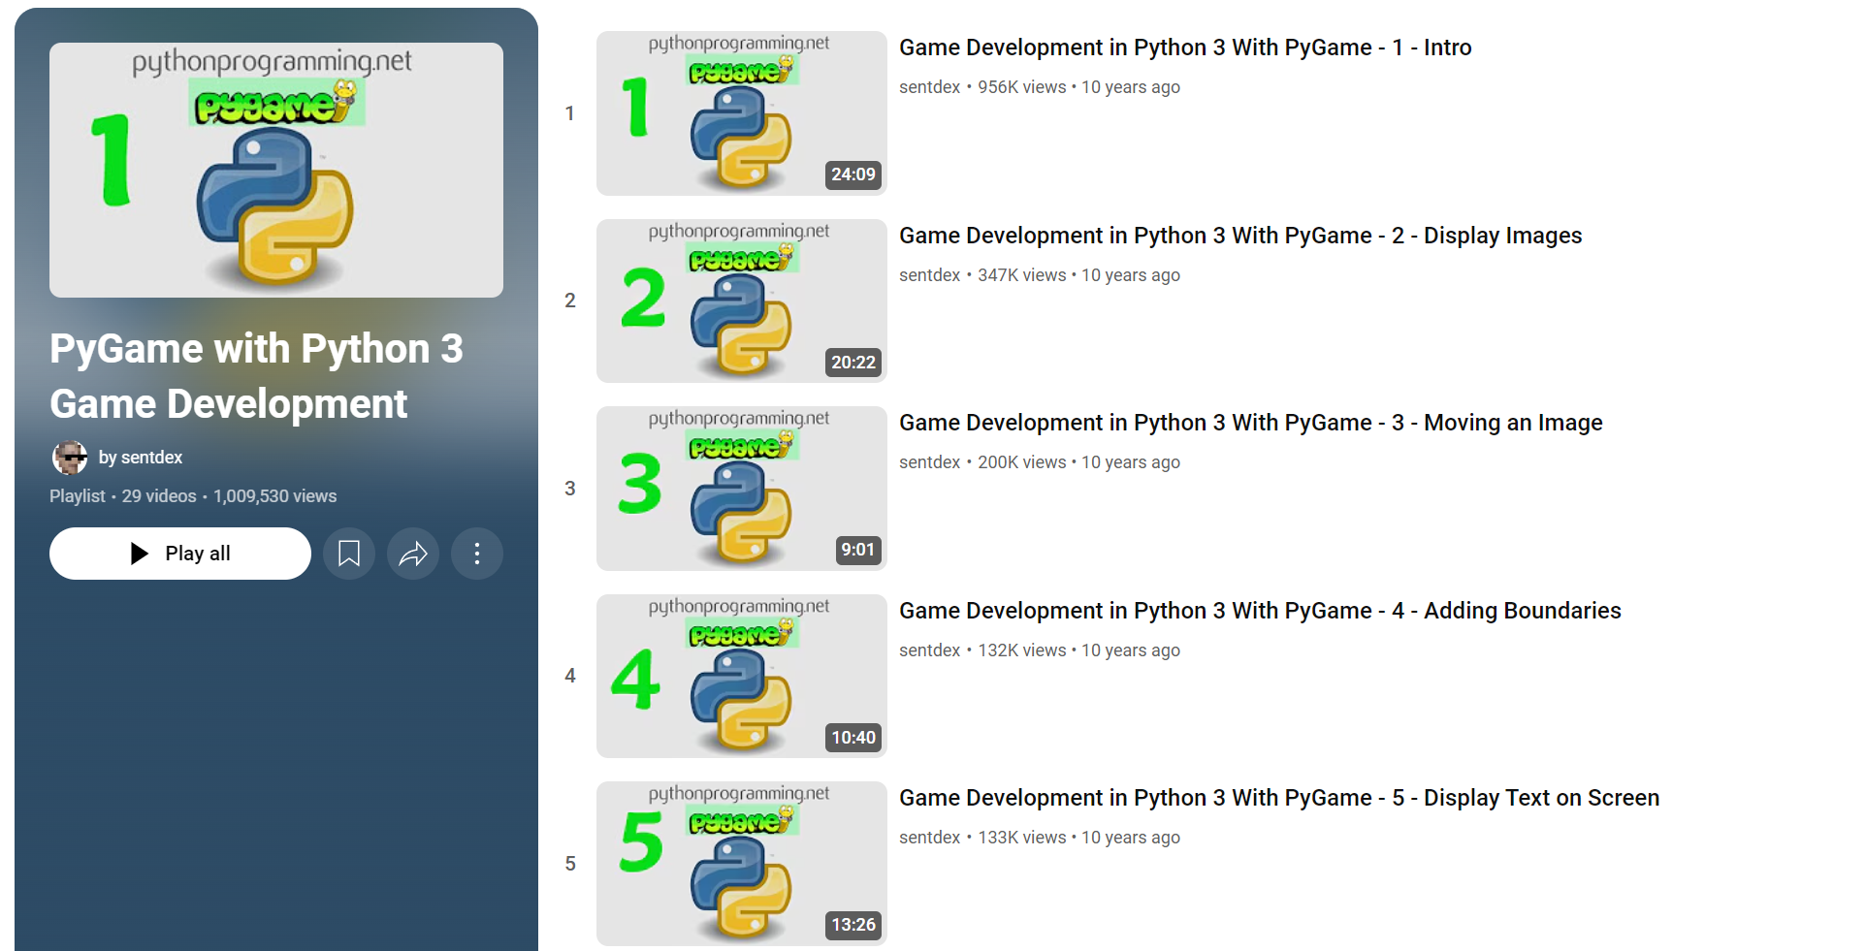
RESOURCES
Check OLE for the most up to date information (see links to resources and tutorials)
CodeAvengers/GrokLearning Tutorials
Optional: Pygame tutorials on youtube

Slide 19
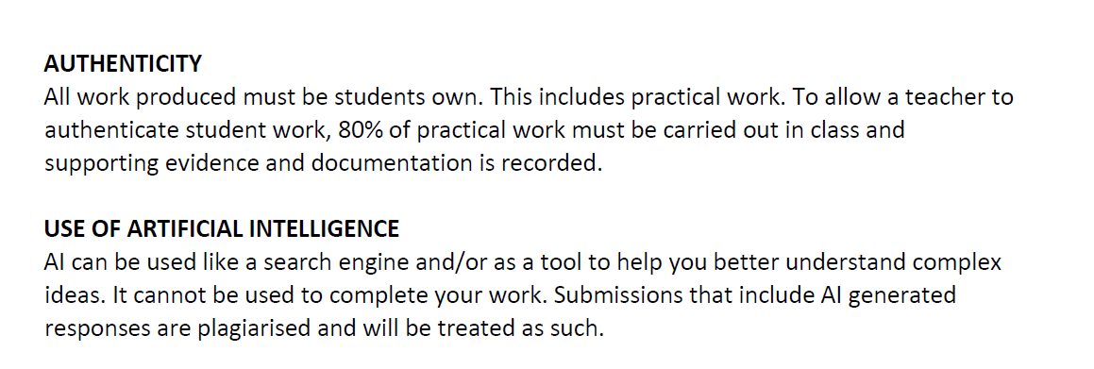
AUTHENTICITY AND AI USE
Please check the Technology Assessment Policy on the OLE for further information.

